Slide 1
Radzików, 05-870 Błonie
Tel: (48) 22 733 45 00, Fax: (48) 22 725 47 14
www. ihar.edu.pl

Slide 2
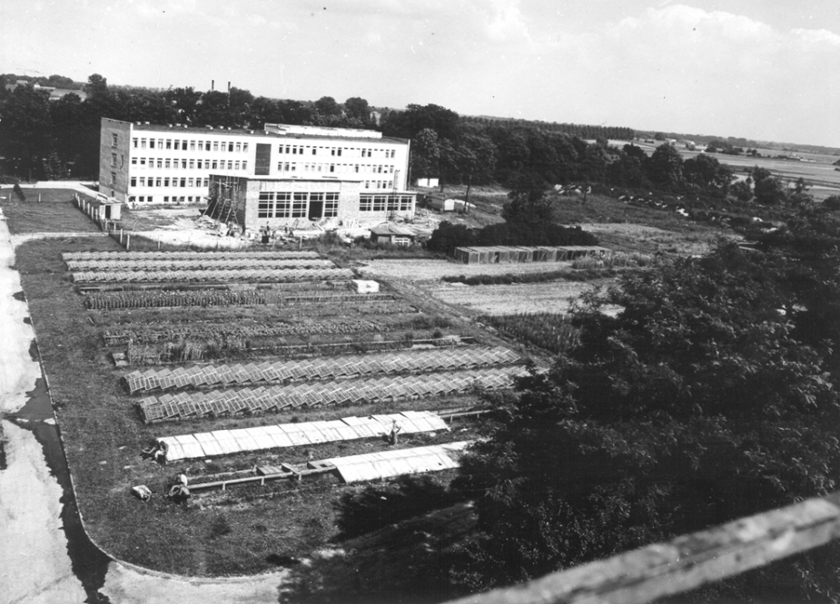
Cereals
Potatoes
Oilseed rape
Grasses
Legumes
Maize
History …
The Institute was created in 1951 as a scientific institution set up to conduct research in the field of crop breeding and seed science, as well as in the field of agricultural (bio)technology for oil and root crops.

Slide 3
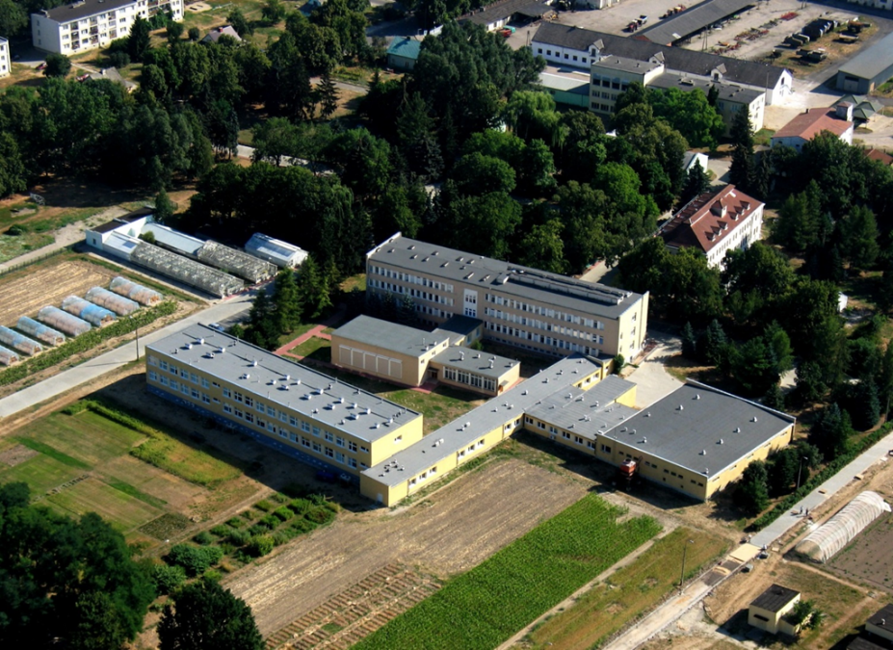
Cereals
Potatoes
Oilseed rape
Grasses
Legumes
Maize
Today …
In 2010, the IHAR obtained the status of the National Research Institute. Currently, we perform basic research with a strong focus on translating scientific results into agricultural and industrial applications. IHAR mission is to conduct frontline research in life sciences for the benefit of scientific progress and the benefit of society.

Slide 4
Cereals
Potatoes
Oilseed rape
Grasses
Legumes
Maize
About the Institute’s budget …
Budget - amounts receivable within one year:
Government funding - MA&RD 25%, MS&HE 14%, grants 10%
Experimental Stations activity - 37%
Other operating and financial income - 11%
Orders of business entities - 4%

Slide 5
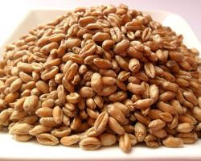
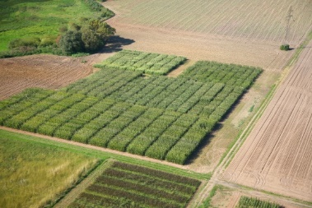
Cereals
Potatoes
Oilseed rape
Grasses
Legumes
Maize
About the Institute’s budget …
IHAR is a life science research institute, subjected to the Ministry of Agriculture and Rural Development.
MA&RD financial support includes:
Program 2016-2020: Creating the scientific basis for biological progress and protecting plant genetic resources as a source of innovation and support for sustainable agriculture and food security of the country.
Program 2014-2020: Basic research for biological development.

Slide 6
Cereals
Potatoes
Oilseed rape
Grasses
Legumes
Maize
About the Institute’s scientific obligations …
Financial support from the Ministry of Science and Higher Education …
… contributes to support the scientific excellence, thus comes with obligations - every four years the Institute is evaluated according to criteria:
the number of publications, patents,
income from from national and international projects,
income from industrial collaboration,
capacity to attract industrial
and international funding,
creation of startups,
authoring of Ph.D. theses.
X
X

Slide 7
Cereals
Potatoes
Oilseed rape
Grasses
Legumes
Maize
Organizational structure of the Institute …
IHAR-PIB
Research Centers
Radzików
Bonin
Bydgoszcz
Jadwisin
Młochów
Poznań
Experimental Stations
Breeding Companies
Bartążek
Bonin
Grodkowice
Nieżychowice
Oleśnica Mała
Radzików
Plant Breeding Smolice Ltd.Co.
Plant Breeding Strzelce Ltd.Co.
Potato Breeding Zamarte Ltd.Co.
Agro Inserwis Ltd.Co
Plant Breeding Grunwald Ltd.Co.

Slide 8
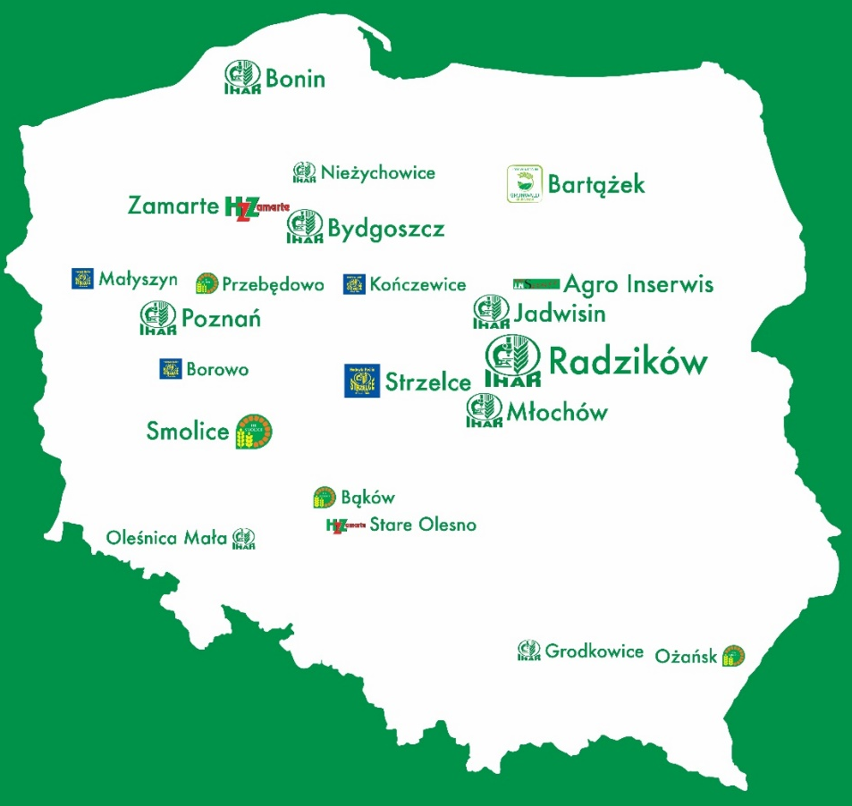
Cereals
Potatoes
Oilseed rape
Grasses
Legumes
Maize
Location of the Institute …
Management
Research Centers
Experimental Stations
Breeding Companies

Slide 9
Cereals
Potatoes
Oilseed rape
Grasses
Legumes
Maize
Employees in the Institute …
The IHAR-PIB employs 482 persons
in the scientific departments: 324 persons (108 scientists);
40 assistants;
59 adjuncts;
18 professors of the Institute;
11 professors;
in the experimental stations: 124 persons.

Slide 10
Cereals
Potatoes
Oilseed rape
Grasses
Legumes
Maize
Some scientific and innovative activities …
Identification of genetic resources of the important agronomic traits, the basic studies on their genetic control and methods of utilization.
Research on the physiological mechanisms controlling crop resistance to diseases, pests and environmental abiotic stresses (drought).
Application of biotechnological methods in plant breeding and plant transformation.

Slide 11
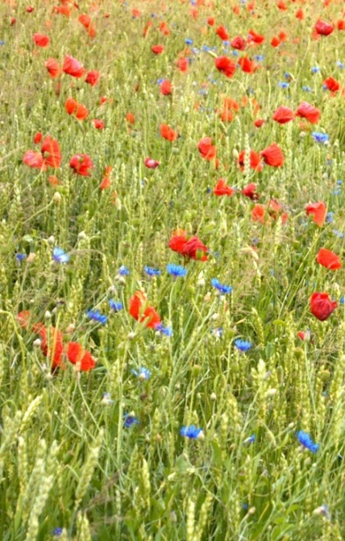
Cereals
Potatoes
Oilseed rape
Grasses
Legumes
Maize
The scientific and innovative Institute activity…
Development and production of starting materials for breeding, including the creation of initial breeding materials and new varieties suitable for cultivation in different conditions and ways of usage.
Development and using molecular selection methods and in vitro culture techniques.

Slide 12
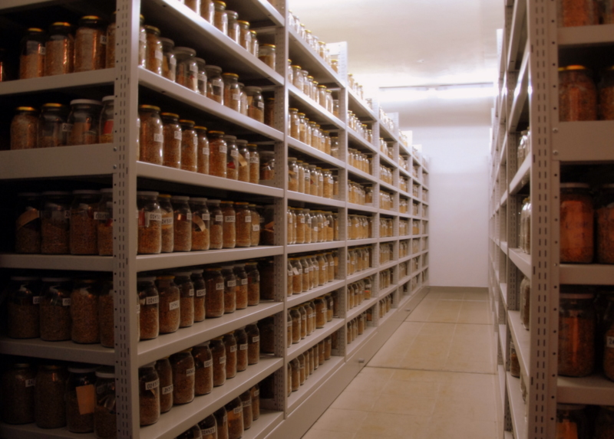
Cereals
Potatoes
Oilseed rape
Grasses
Legumes
Maize
The scientific and innovative Institute activity…
Plant Genetic Resources Program, with the objective of conservation of genetic variability of crop plants endangered with genetic erosion in Poland.

Slide 13
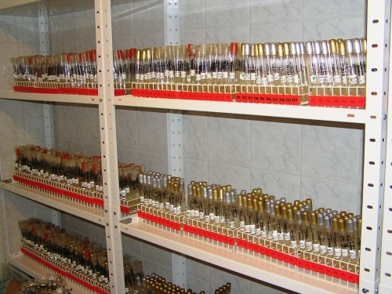
Cereals
Potatoes
Oilseed rape
Grasses
Legumes
Maize
Some scientific and innovative activities …
Identification, collection, and maintenance of the pathogen isolates.
Monitoring changes in pathogen populations in Poland.
Disease resistance testing.
Search for new sources of resistance and identification of molecular markers linked to the resistance.

Slide 14
Cereals
Potatoes
Oilseed rape
Grasses
Legumes
Maize
Some technological activities …
Crops production technology, including new telemetric methods and development of smart farming technologies.
Determination of the quality of the end-uses product from new varieties and advanced breeding materials, including evaluation of nutritive value.
Expertise …
Scientific and technical expertise
for MA&RD, public and industrial
entities.

Slide 15
Cereals
Potatoes
Oilseed rape
Grasses
Legumes
Maize
Some international projects…
G2P-SOL
Understanding and utilising a genetic diversity basing on tens of thousands of genetic accessions of the major Solanaceous crops, stored in ‘genebanks’ worldwide.
Establishment, development, and adaptation of innovative molecular breeding tools for shortening the breeding cycle duration of rapeseed; development of technological enzymatic processes for the valorisation of rapeseed products, and assessment of economic, ecological and social aspects of the novel prototype products.

Slide 16
Cereals
Potatoes
Oilseed rape
Grasses
Legumes
Maize
Some international projects…
Understanding wheat rust fungi
biology and drivers; development
of knowledge about resistance specificities in European wheat germplasm, new approaches for
off-season assessment of host resistance, and the impact of resistance gene diversification on preventing rust epidemics at the landscape scale.
Development (a) methods, strategies,
infrastructures for organic breeding
and production of high-quality organic
seed, (b) varieties with an improved
stress resistance, resource use efficiency and technological quality.

Slide 17
Cereals
Potatoes
Oilseed rape
Grasses
Legumes
Maize
Research and diagnostic services in the field of …
resistance assessment, detection, and identification of pathogens,
biochemical analysis and evaluation of the quality of plant products,
production of prebreeding material by recombination and biotechnological methods,
genetic identification and research on the expression and presence of genes (fingerprinting),
detection and identification of GMOs for plant breeding,
turfgrass and turf surfaces expertise and advisory services,
evaluation of the potato varieties for
the farming system used in agriculture
(e.g. ecological).

Slide 18
Cereals
Potatoes
Oilseed rape
Grasses
Legumes
Maize
Thank you very much for your attention …

